Slide 1
UAV Photogrammetric Thermography for Building Performance: A Prototype
UCF / IST / IDS6938 : Building Performance Simulation

Slide 2
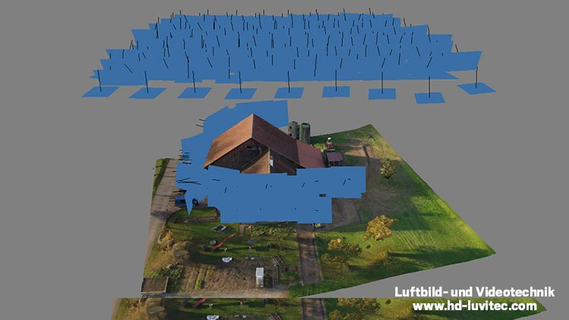
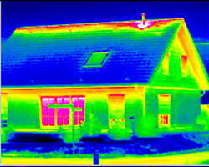
Project Overview
Photogrammetry
Infrared

Slide 3
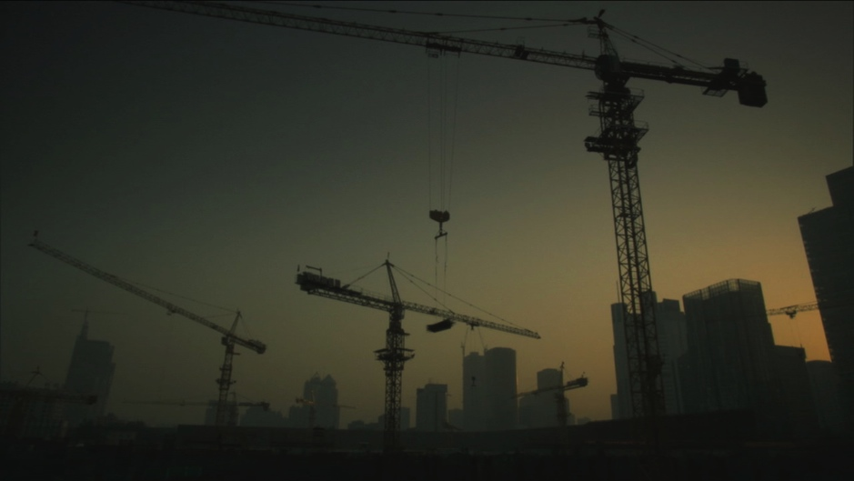
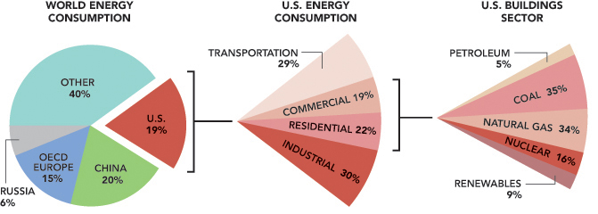
Why?
Buildings (+ manufacturing for construction) accounts for at least 50% of energy use in the world

Slide 4
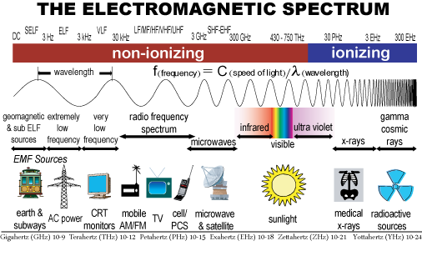
Why IR?
Why Not?
300nm – 700nm

Slide 5
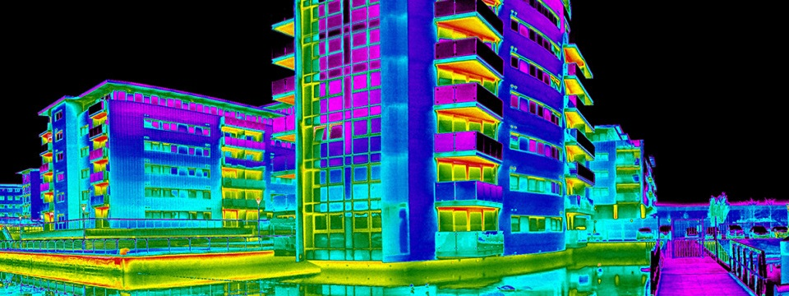
Monitoring / Maintenance

Slide 6
Project Overview
Photogrammetry of buildings, visible and IR energy
Use drones to carry cameras and capture video from pre-programmed flight path around buildings/sites
Capture both visible (RGB) video and IR video
Strip and post-process select frames from videos
Stitch frames with modern photogrammetry software to create 3D models
Inspect, cleanup, analyze resulting 3D models

Slide 7
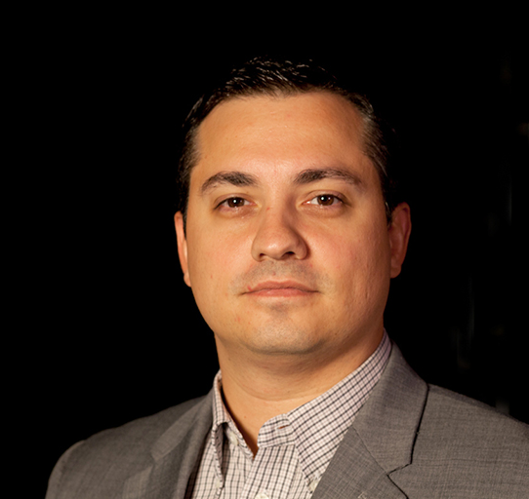


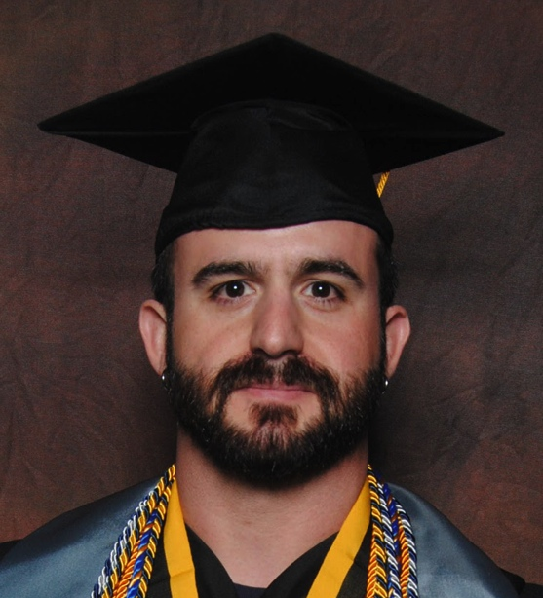
Team
Joseph Del Rocco
Computer Science, Ph.D. Student
University of Central Florida
Full Sail University
joe.delrocco.org
Joseph Kider
Assistant Professor
Institute for Simulation & Training
University of Central Florida
josephkider.com
Keith R. MacArthur
Modeling & Simulation, Ph.D. Student
University of Central Florida
Institute for Simulation & Training
MIT² Laboratory
keith.macarthur@knights.ucf.edu
(our advisor)

Slide 8
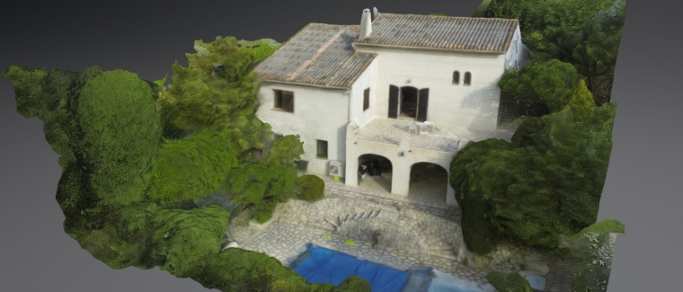
Prior Work 3D reconstruction of a house using a drone ^{[9]}
http://gaetanlaure.com/3d-reconstruction-of-a-house
https://skfb.ly/UFnr

Slide 9
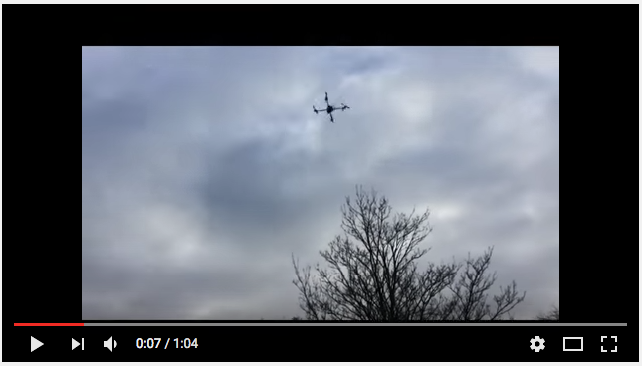
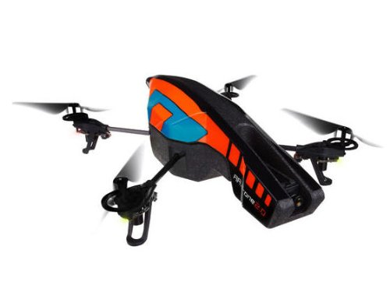
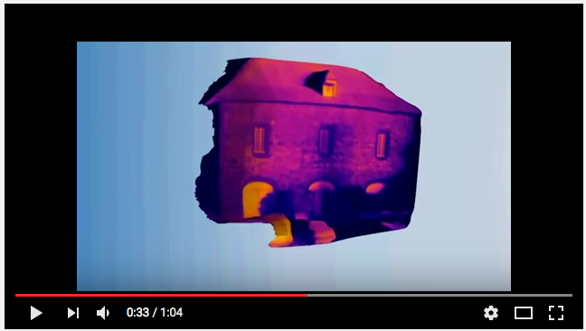

Prior Work The use of Unmanned Aerial Vehicles in Building Inspection ^{[1]}
Parrot AR Drone
Mohamed Hafez, 2015
^{[1]}
https://www.youtube.com/watch?v=__rvoMPTc30
https://www.linkedin.com/in/mohamed-hafez-7b3b8796

Slide 10
Prior Work The use of Unmanned Aerial Vehicles in Building Inspection ^{[1]}
“Designed and built a drone to be used in a unique aerial inspection of buildings and refineries.
Thermal data is captured using the drone to produce a thermal 3D mesh.
Developed a unique post-analyses method to detect thermal leaks, gas leaks, damp, and water ingress.
Project has received interest from various engineering companies including Atkins, Costain, and ExxonMobile” ^{[1]}

Slide 11
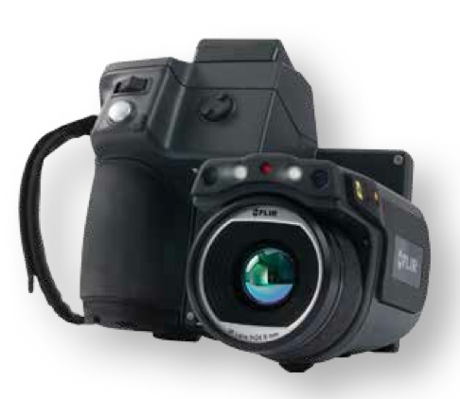
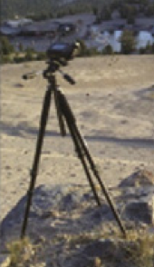
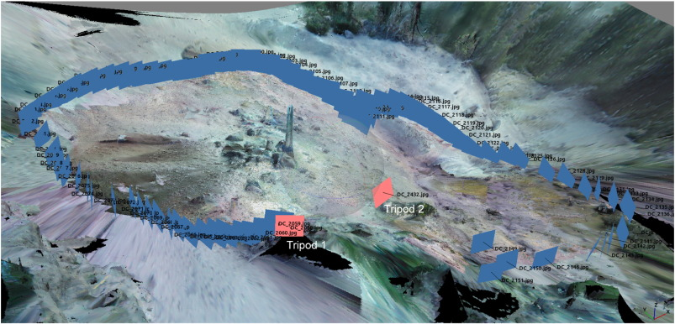
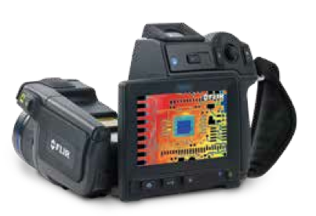

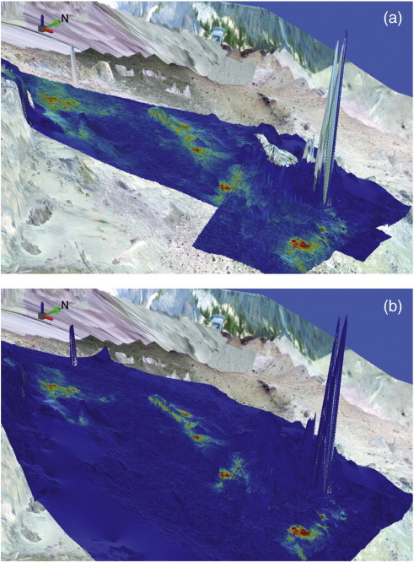
Prior Work Visible and TIR SfM photogrammetry for temperature and heat flux ^{[2]}
FLIR T650sc
traveled on foot
102 RGB photos
2 TIR videos
^{[2]}
^{[2]}
^{[2]}
^{[2]}

Slide 12
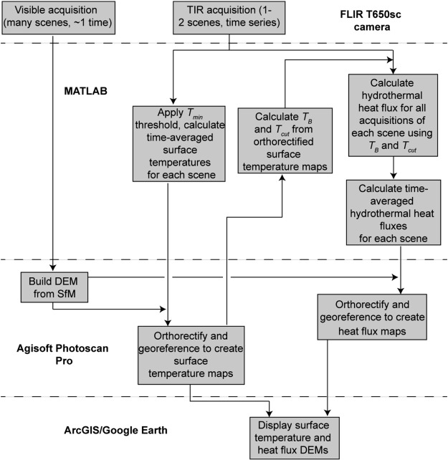
Prior Work Visible and TIR SfM photogrammetry for temperature and heat flux ^{[2]}
^{[2]}

Slide 13
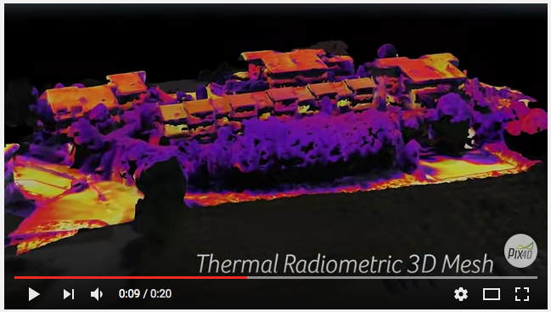
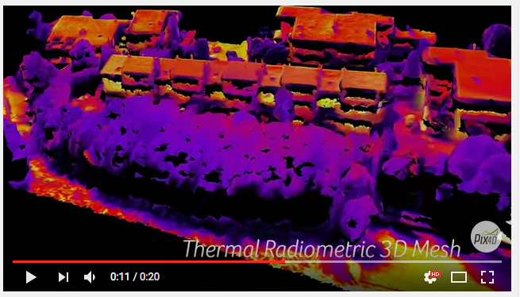
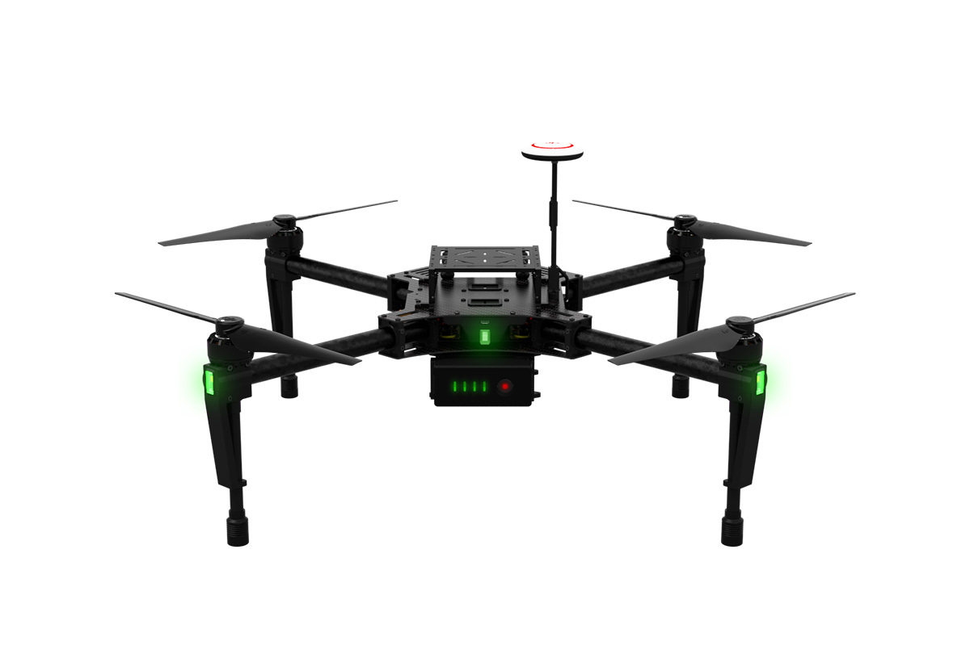
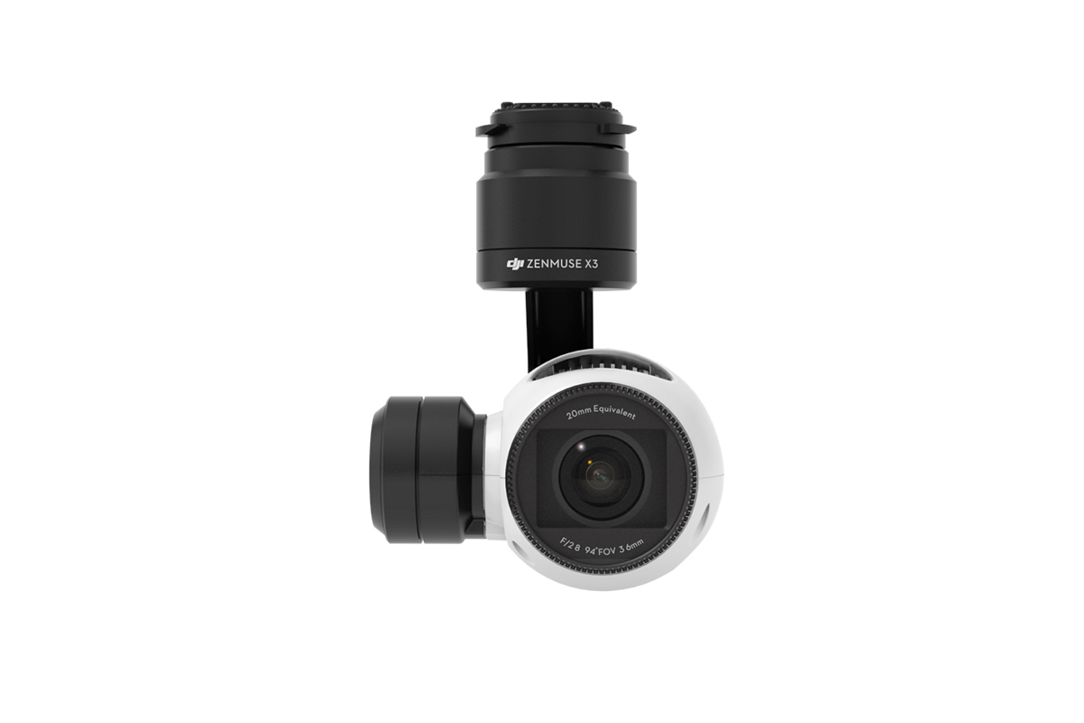
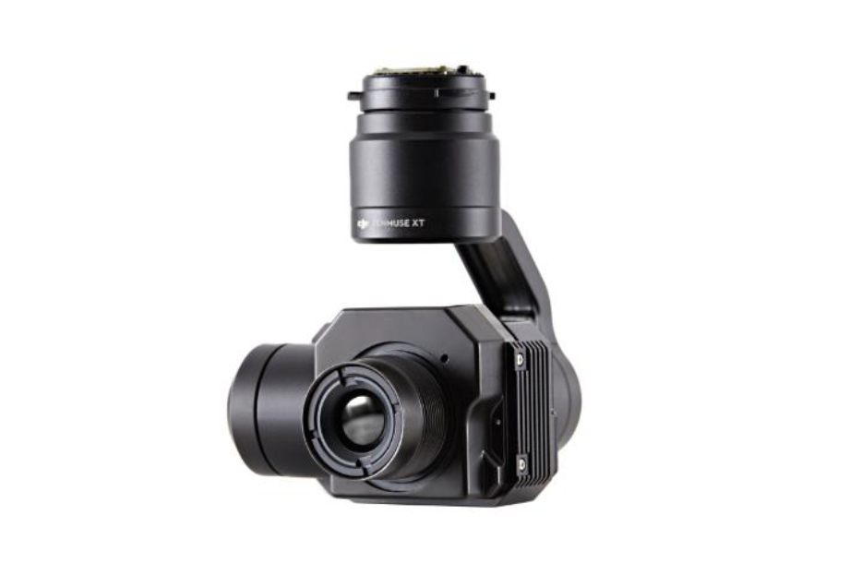
Prior Work Done-based Thermal Modeling ^{[3]}
DJI Matrice 100 + Zenmuse X3, XT
https://www.youtube.com/watch?v=x-jp9a1bpVU
Analyst Group
Pix4DM
“Overlay of thermographic (radiometric) and RGB 3D meshes of an urban area in Italy, captured with FLIR Tau 2 sensor by Analist Group, processed with Pix4Dmapper.” ^{[3]}

Slide 14
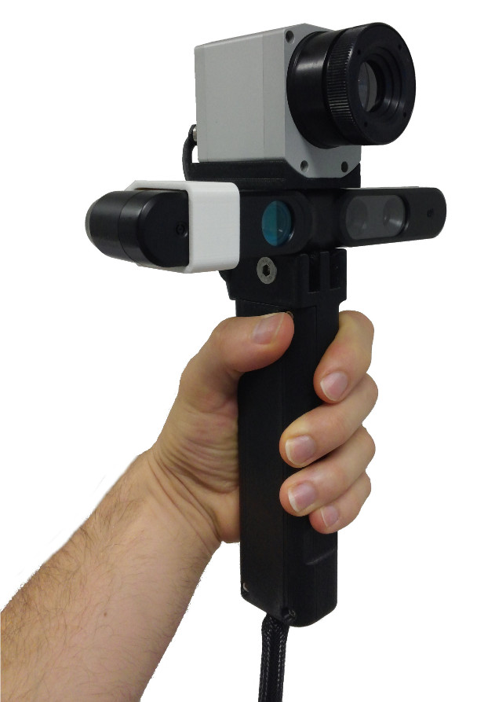
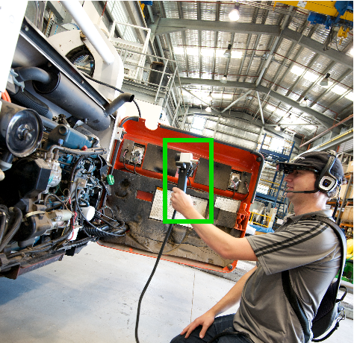
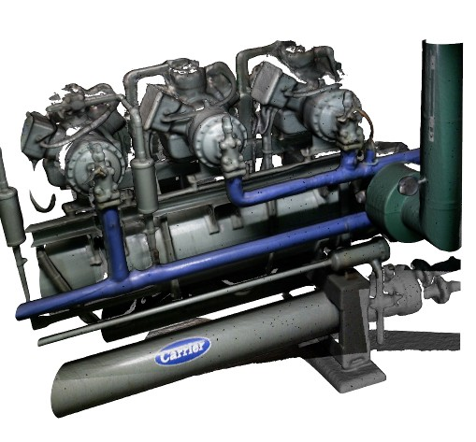
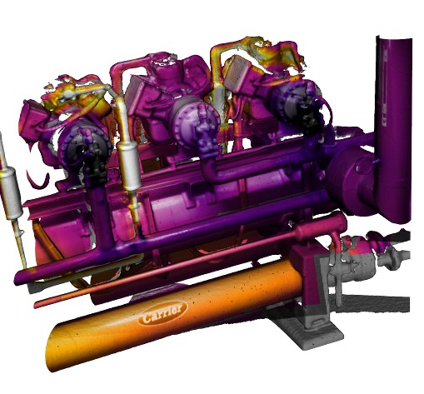
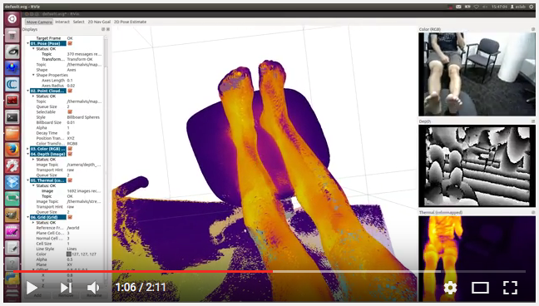
Prior Work HeatWave: A handheld 3D thermography system ^{[6]}
“The output of HeatWave is a single complete 3D multispectral model with high accuracy, view independent augmented temperature and visible information to detect any appearance, shape, temperature or temporal changes within the environment. The dense, high-resolution 3D multispectral model can be visualized in either modality independently or both simultaneously using “Spectra” the world’s first 3D multispectral visualization toolbox developed by HeatWave’s team at Autonomous Systems..” ^{[6]}

Slide 15
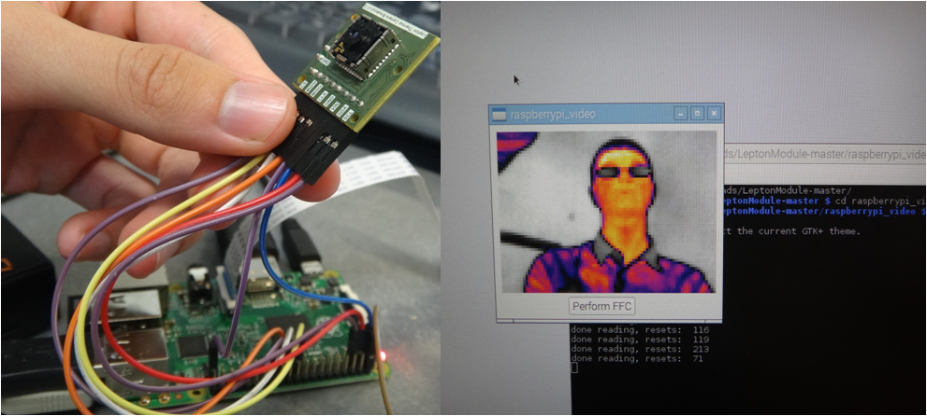
Prior Work Low Cost Thermal Imaging System (for drones) ^{[7]}
Low Cost Thermal Imaging System
Advanced Control and Intelligent Systems Laboratory (ACIS)
University of British Colombia
http://acis.ok.ubc.ca/?page_id=1165
“ACIS is currently developing a lightweight low cost thermal imaging system for Unmanned Aerial Vehicles (UAVs). Applications for thermal cameras onboard UAVs include Search & Rescue and forest fire monitoring.” ^{[7]}

Slide 16
Expected Outcomes (prototype)
A working pipeline for photogrammetry with drones
hardware: drone, cameras, control, etc.
software: controlling, recording, stitching, viewing, etc.
process: setup, calibration, testing, scaling, workflow
3D models, both visible and thermal
An impressive enough prototype to warrant a professional experiment
Possibly acquire some useful analysis with models (?)

Slide 17
General Attack Plan
Acquire + configure drones with RGB cameras
Test RGB video capture of small object (car, etc.)
Process video
Use/write code to strip subset of frames from video
Identify any post-processing needed
Push frames to photogrammetry software for 3D model
Use off-the-shelf software
Use service/API if possible
View 3D model in off-the-shelf modeling software
Post process if necessary
Acquire + configure IR camera
Wire camera
Test read IR data
Attach camera to drone
Repeat experiment of small object w/ both cameras attached
Confirm everything is working as expected before moving on to a building/site
Attempt experiment with residential property
Smooth any pre/post processing steps
Try a UCF / IST building
Get permission first
Make sure Joe is around
Collect all measurements, present results in paper and pres.

Slide 18
Checkpoint Goals
Visible energy to 3D geometry (standard photogrammetry):
Captured useable RGB video from drone (small object)
Stripped/processed select frames from RGB video
3D model from frames + photogrammetry software
IR energy to 3D geometry:
Captured useable IR video from drone (small object)
Stripped/processed select frames from IR video
3D model from frames + photogrammetry software
Real experiment with building
Paper and presentation

Slide 19
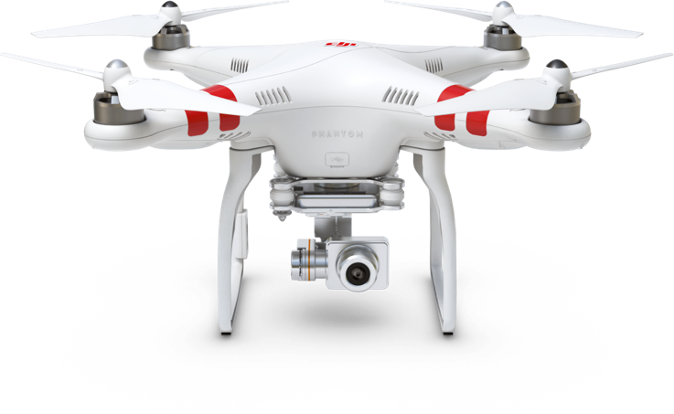
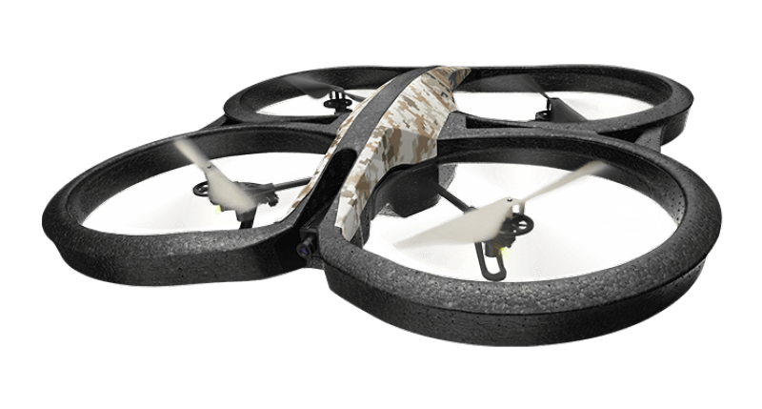
Equipment: Drones
DJI Phantom 2 Vision+
Flight time: 25m
Payload: 300g
Frequency: 5.85Ghz
Parrot AR.Drone 2.0
Flight time: 12m
Payload: 100g
Frequency: 2.4Ghz
^{[8]}
^{[8]}

Slide 20
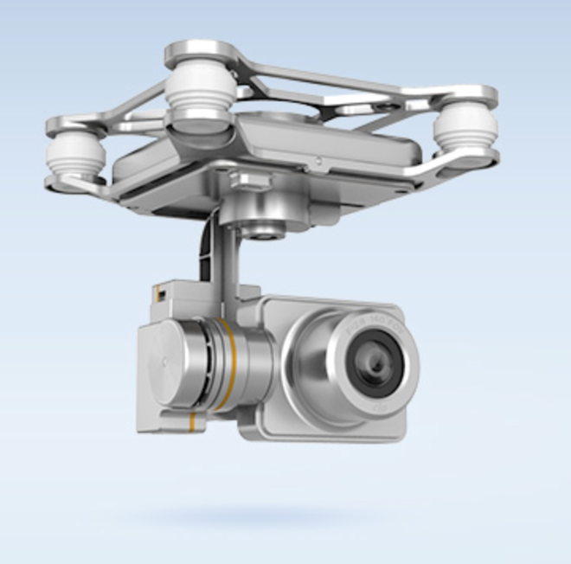
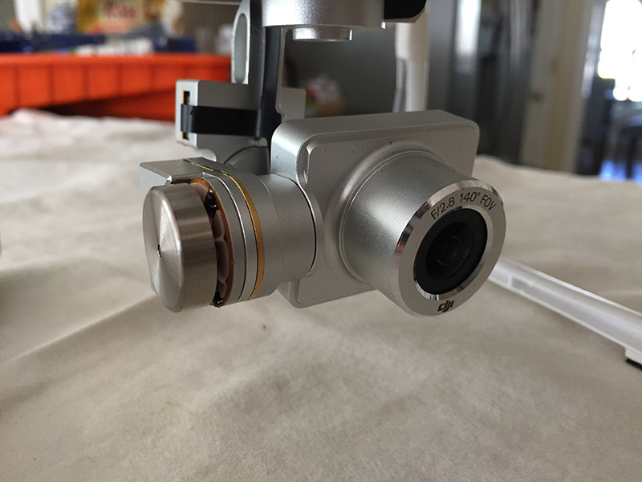
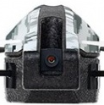
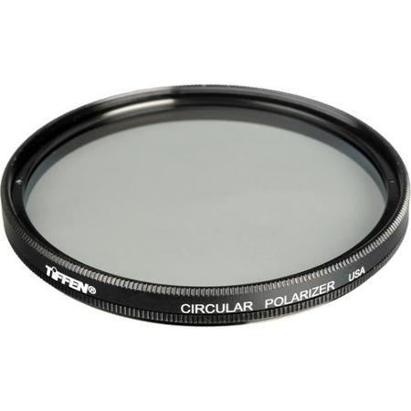
Equipment: Visible (RGB) Cameras
DIJ Phantom 2 Vision+ camera
1920 × 1080 30p
110°/85° hfov, 140mm f/2.8, ISO 100
Parrot AR.Drone 2.0 Canon EOS 7D
1280 × 720 30p
92° hfov, 38mm f/5.6, ISO 160
Tiffen Circular Polarizer Filter
30mm
“Filter can be rotated to achieve desired effect” (?)

Slide 21
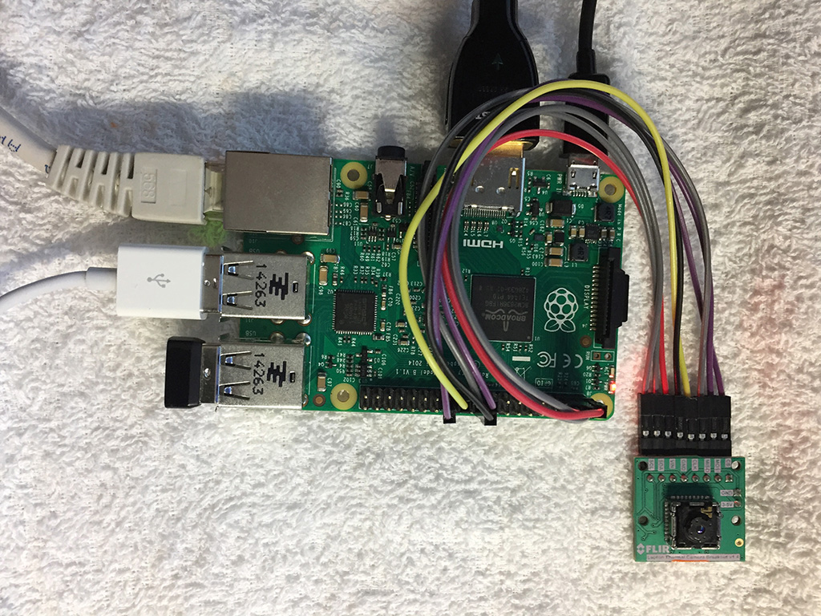
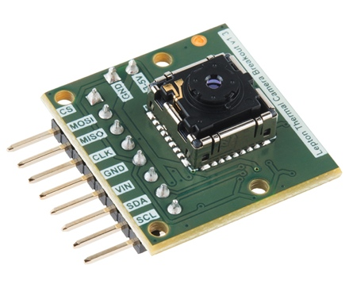
Equipment: IR (thermal) Camera
FLiR Lepton LWIR Imager (on breakout board)
80 × 60 active pixels
51° hfov, 63.5° diagonal
Wavelengths 8 to 14 μm
Thermal sensitivity <50 mK

Slide 22


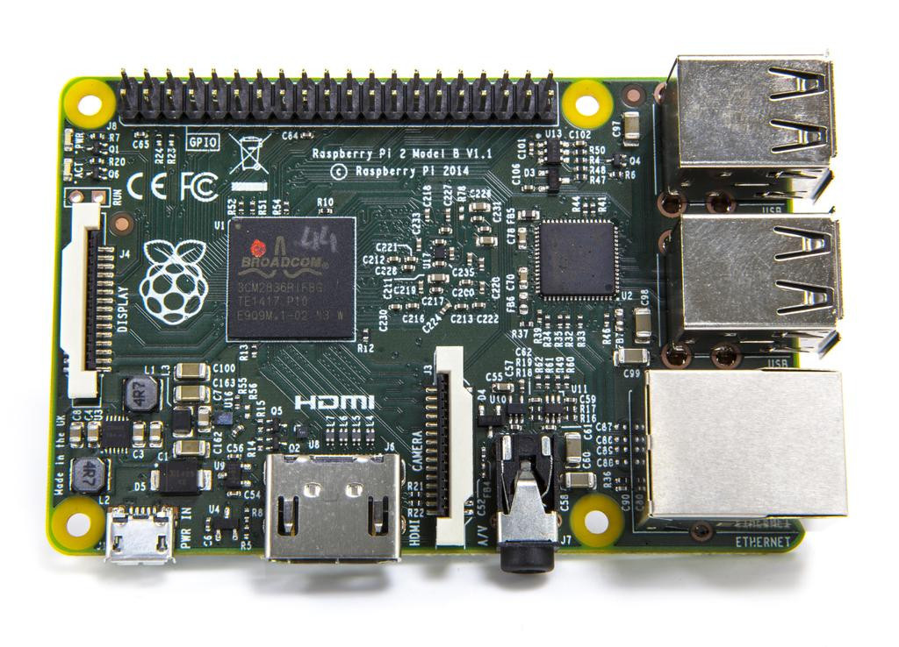
Equipment: IR Controller
Raspberry Pi 2 Model B v1.1 (2014)
Broadcom BCM2836 ARMv7 Cortex-A7 4core 900MHz
512MB RAM
Micro SD card
40pin GPIO
4 USB ports
CSI camera port
DSI display port
HDMI
Micro USB power

Slide 23
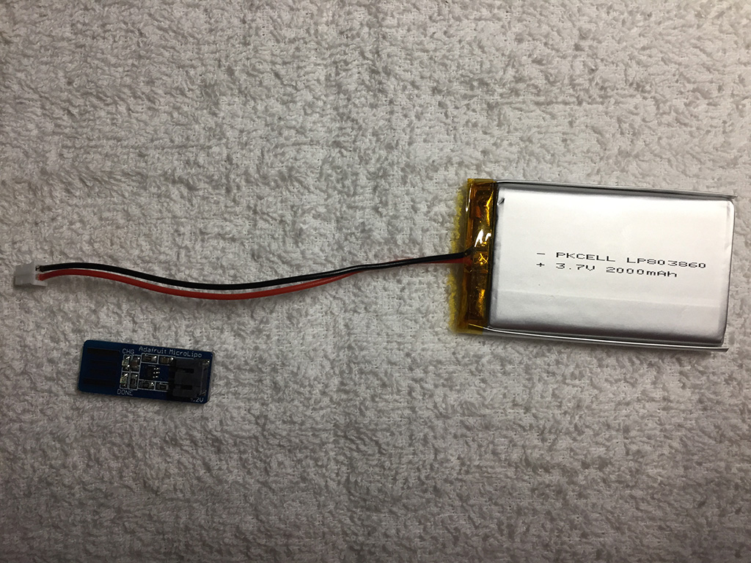
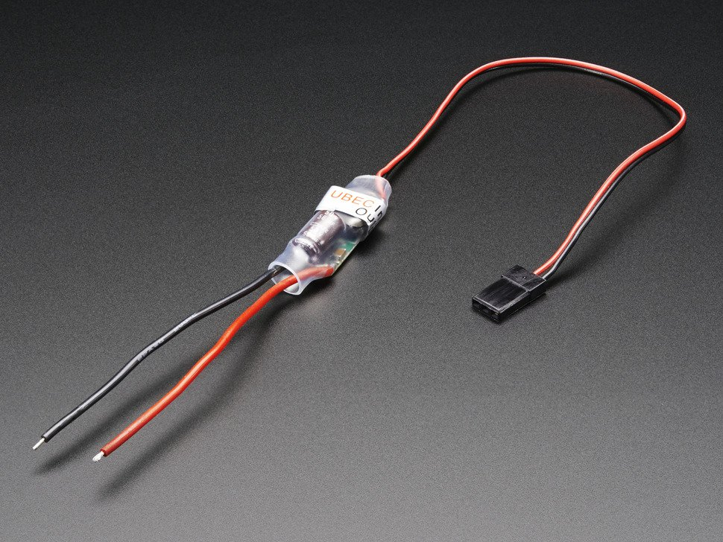
Equipment: Power Source (1)
Shenzhen PKCELL LP803860 battery (x2)
Lithium ion polymer (LiPo)
3.7v (4.2v max charge)
2000mAh
USB charger (100-500mA)
UBEC DC/DC 5v Step-Down (Buck) Converter
Raspberry Pi needs 5v to support perhiperals

Slide 24
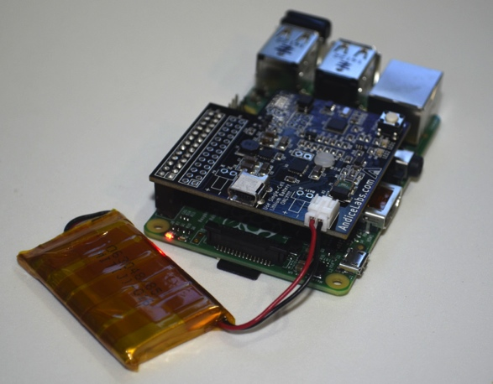
Equipment: Power Source (2)
http://andicelabs.com/shop/andicelabs/power-pi/

Slide 25
Equipment: Payload Estimate
equipment | weight
RPi controller | 40g
LiPo battery | 48g x2 = 96g
UBEC step-down converter | < 10g
IR camera + board | < 10g
switch + wires | < 15g
total weight | < 170g

Slide 26
Equipment: Software
Drone Control:
DJI controller + DJI Vision iOS app for Phantom 2 Vision+
UgCS Ground Station for both Phantom or Parrot
IR Camera Controller:
Fedora Linux + Raspberry PI API
FLiR Lepton sample source (C/C++) + Netpbm lib
Video Frame Processing:
Python + ffmpy (ffmpeg)
Photogrammetry:
Autodesk Remake
Agisoft PhotoScan Pro
3DF Zephyr Pro

Slide 27
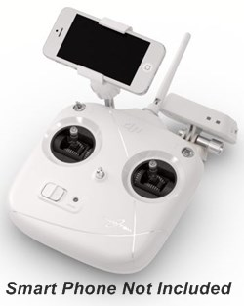
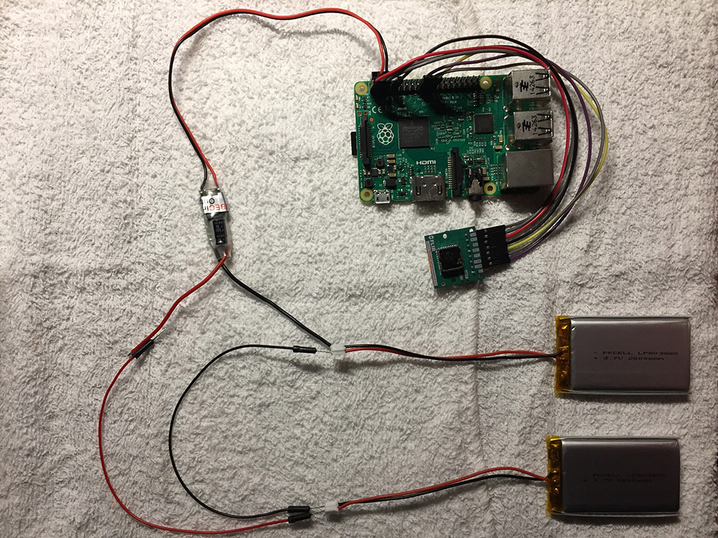
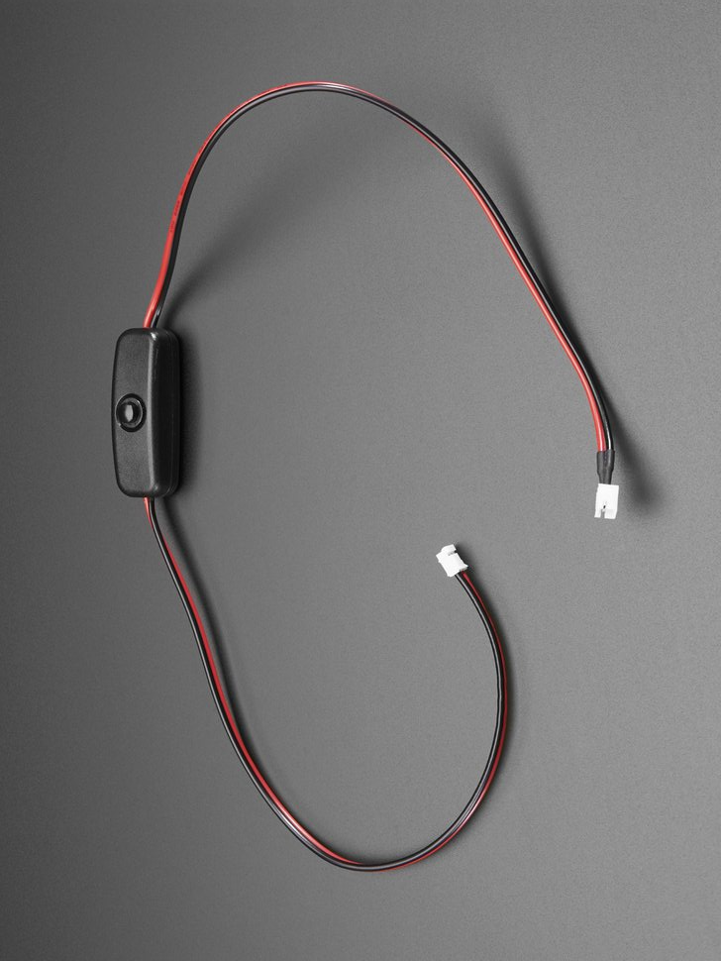
Final Rig (mockup)

Slide 28
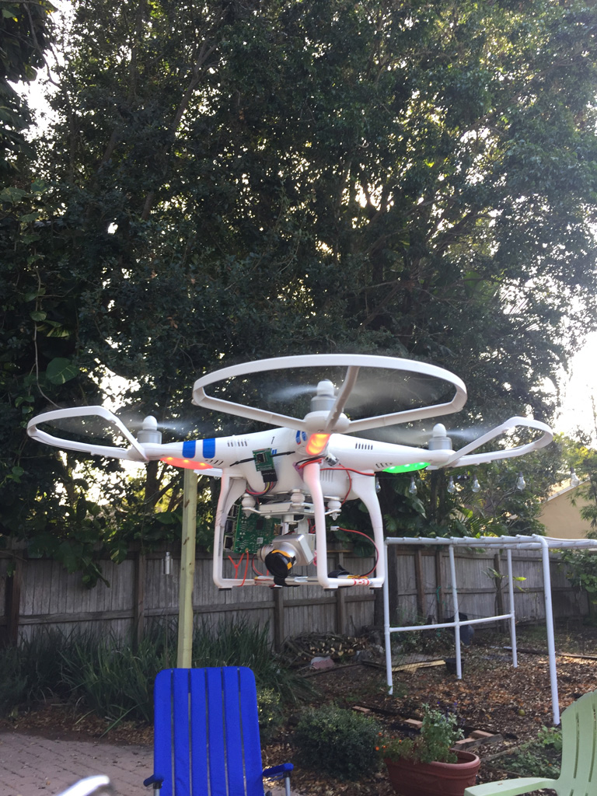
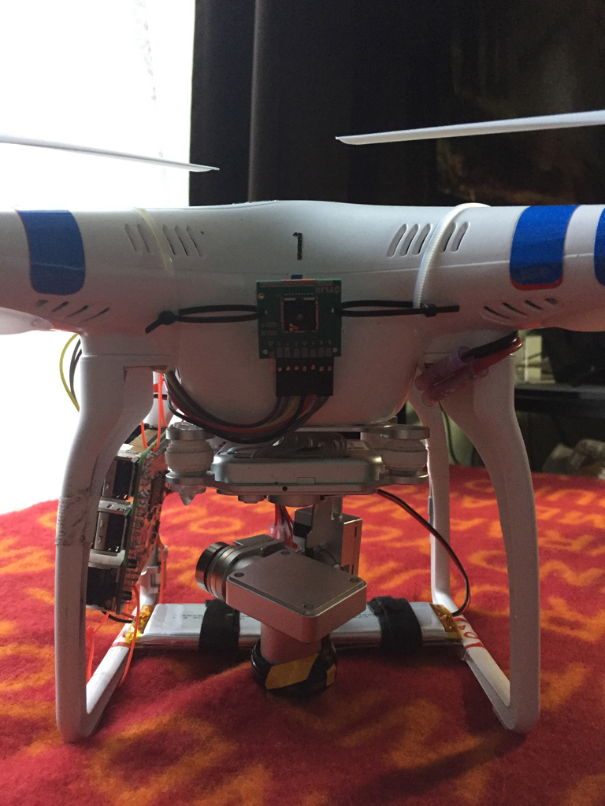
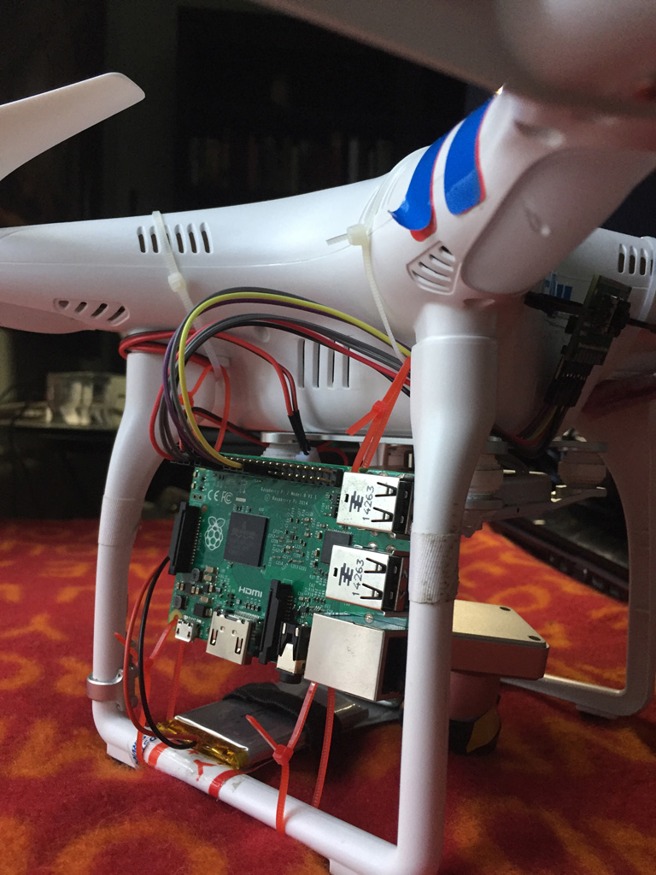
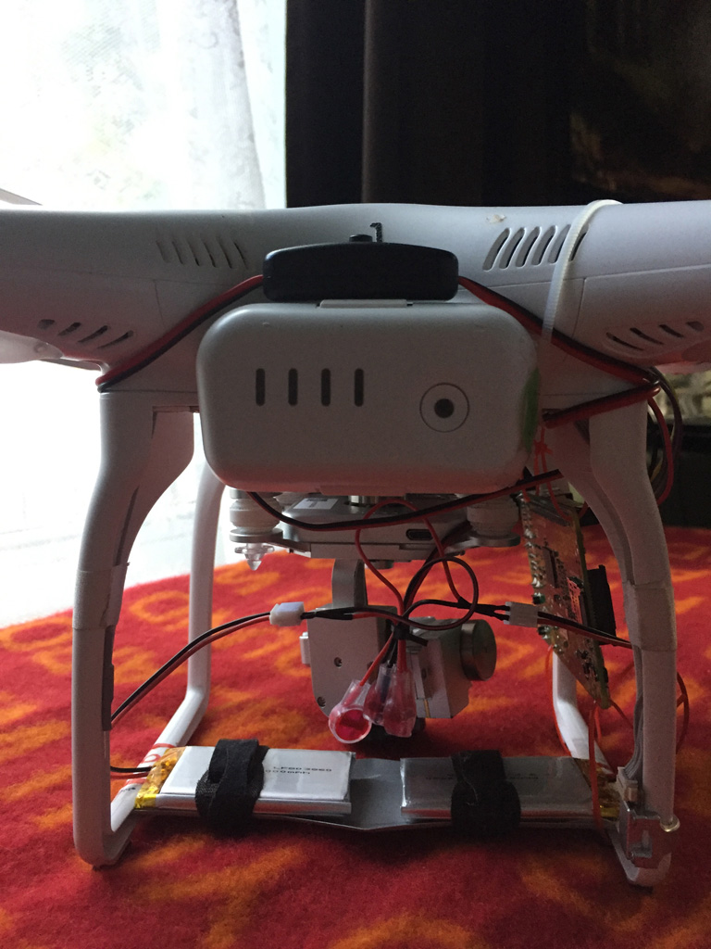
The Therminator ™

Slide 29
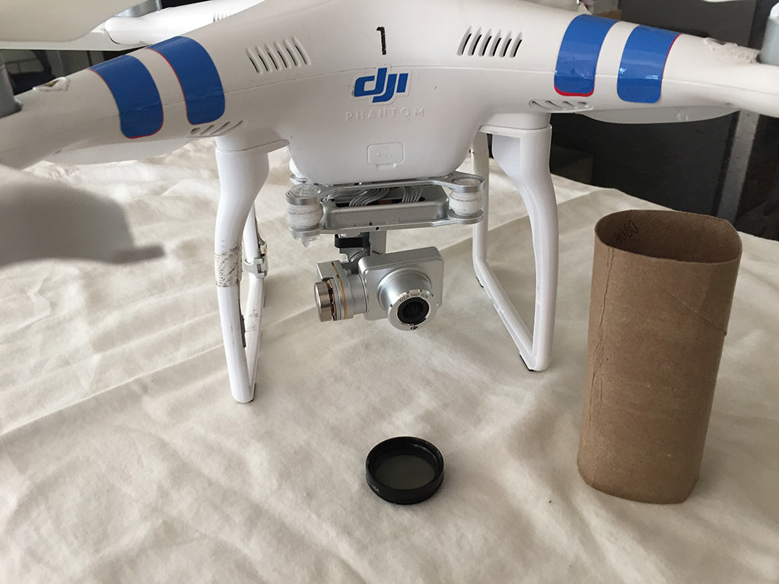
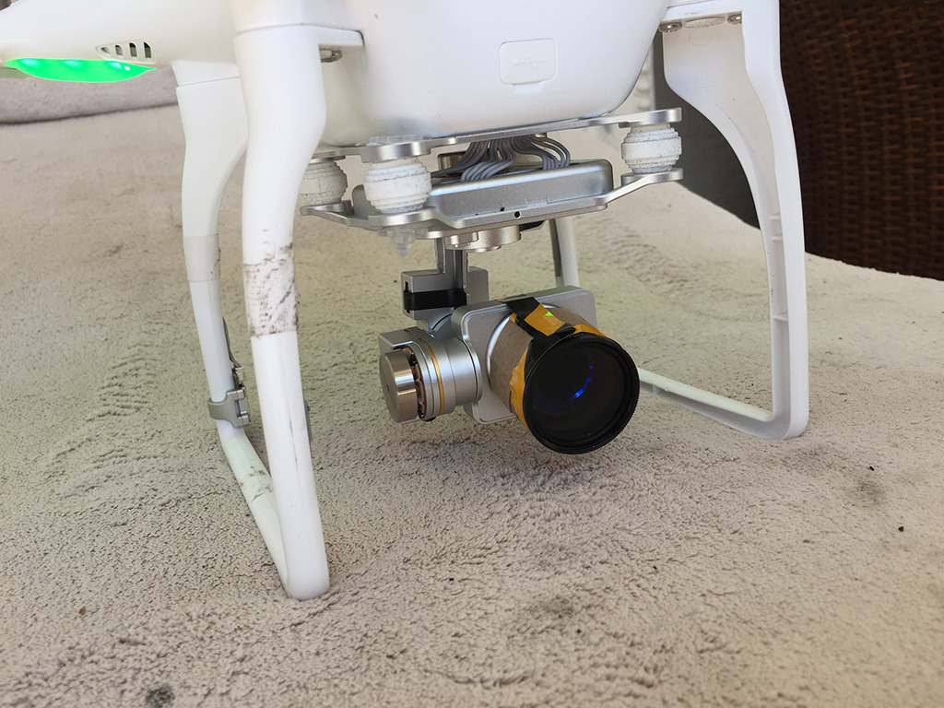
Method: Polarizing Lens (30mm)

Slide 30



Method: IR Capture

Slide 31



Method: Drone Flying

Slide 32









Method: Captures

Slide 33





Method: Resolution Experiment
Downscale a high res photo to equivalent resolution of IR camera
Upscale it back to original resolution
Measure loss of accuracy
Intensity map shows amount difference per pixel
diff
1024 x 576
1920 x 1080
Loss of accuracy is comparable at various resolutions, indicating that we don’t have to upscale IR photos to highest resolution.

Slide 34

Method: Resolution Experiment
https://rosettacode.org/wiki/Percentage_difference_between_images#Python

Slide 35




Problem: 110° HFOV of Phantom 2V+
. . .

Slide 36

Problem: 110° HFOV of Phantom 2V+

Slide 37



Solution: Lens Correction Filter
Andrew Shears “Geography & Mapping/GIS Dude” http://andrewshears.com/2014/10/08/lens-correction-on-dji-phantom-2-vision-for-mapping

Slide 38



Solution: Set FOV to 85°
Isotropic materials are not good candidates for photogrammetry because objects appear the same from multiple directions.

Slide 39
Problem: Manual Control of Drone
Looking at drone alone is insufficient
Cannot ensure object is centered in view
Looking at mobile device camera feed is insufficient
Cannot see objects near drone
Flying drone manually is ok, but not ideal
Object will likely not be centered
Manually navigating obstacles is stressful and dangerous
Solution: Use waypoint control software!

Slide 40






Solution: Waypoint Software
DJI Ground Station
UgCS Ground Control

Slide 41




Results: 3D Model from Visible

Slide 42

Results: 3D Model from Visible

Slide 43

Results: 3D Model from Visible

Slide 44

Results: 3D Model from Visible

Slide 45

Results: 3D Model from Visible

Slide 46


Results: 3D Model from IR
visible
IR

Slide 47
Beyond Prototype (Future Work)
More formal experiment with better infrastructure
stronger, longer flight-time drone
better resolution cameras
more professional photogrammetry processing(?)
Full buildings, alternative sites, etc.
Capture more information with same pipeline (multispectral)
Studies
downscaling/upscaling affect on photogrammetry
Viewer plugins for popular modeling packages
extract/select apparent temperature from thermal 3D model

Slide 48
How you can help us ☺
Help us with Orlando drone regulations: - cost per flight - cost per year - insurance policy costs - FAA approvals http://orlando-politics.com/2017/01/23/city-of-orlando-passes-ordinance-regulating-drones
We need better IR equipment!
Let us scan your building and give you data

Slide 49
References
Hafez, M. (February 2015). Photogrammetry Using a Thermal Camera attached to a Drone. Retrieved October 14, 2016, from https://www.youtube.com/watch?v=__rvoMPTc30
Lewis, A., Hilley, G., & Lewicki, J. (2015). Integrated thermal infrared imaging and structure-from-motion photogrammetry to map apparent temperature and radiant hydrothermal heat flux at Mammoth Mountain, CA, USA. Journal of Volcanology and Geothermal Research, 303, 16-24.
Pix4D, Analyst Group. (October 2015). Pix4D - Drone-based Thermal Modeling. Retrieved October 14, 2016, from https://www.youtube.com/watch?v=x-jp9a1bpVU
Moghadam, P. (2015). 3D medical thermography device, Proc. SPIE 9485, Thermosense: Thermal Infrared Applications XXXVII, 94851J.
Vidas, S. and Moghadam, P. (2013). HeatWave: a handheld 3D thermography system for energy auditing. Energy and Buildings 66, 445–460

Slide 50
References
https://confluence.csiro.au/display/ASL/HeatWave
Ephraim, N. (n.d). Low Cost Thermal Imaging System. University of British Colombia, ACIS. Retrieved October 17, 2016 from http://acis.ok.ubc.ca/?page_id=1165
http://drones.specout.com
Laure, G. 3D reconstruction of a house using a drone. Personal website. Retrieved November 28th, 2016 from http://gaetanlaure.com/3d-reconstruction-of-a-house

